Slide 1
FYP Presentation
By Ethan Holohan C20322553
Supervisor: Colette Kirwan
Project Name: Quatermaster

Slide 2
Overview
Airsoft Is a growing hobby
However Rules are complicated between sites
Safety is becoming a larger concern
Aim of this app is to give players more info
And to help staff keep players safe

Slide 3


Existing Solutions
Ares Alpha
More focused on longer games
Doesn't do anything for rules
Airsoft Force Tracking
More Focused on shorter games
No Safety features

Slide 4



Tech Research
Kotlin
NoSQL or SQL
Nearby Connections
Native app or Web App

Slide 5
Background Research
Geofencing
GDPR
GPS
Battery Life Optimisation

Slide 6
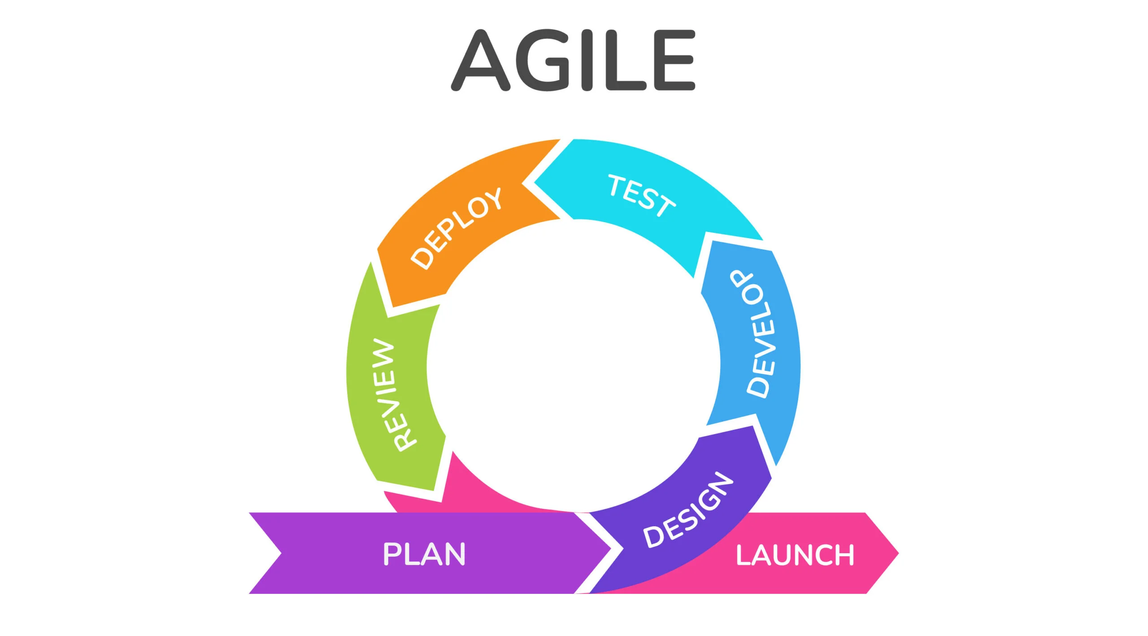
Design: Chosen Methodology
Either Waterfall or Agile
Waterfall is simple for solo projects
Agile results in better management
Agile Kanban was chosen
Helps visualise progress

Slide 7
Design
Using jetpack compose for UI frontend
Koltin for frontend logic
Firebase for backend database

Slide 8
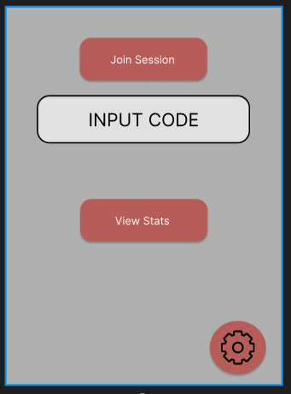
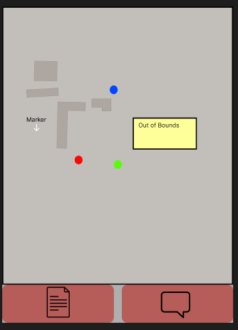
UI Design
UI designed to be simple
with clear buttons
Have a good contrast
between elements

Slide 9
Prototype
Prototype’s goal was to get the main functionality of the app down
Session’s and tracking were implemented

Slide 10
Demo

Slide 11
Issues Encountered
Poor time management
Issues with some documentation

Slide 12
Future Work
Finalise the design
Potentially move to a mongoDB or postgres database
Start Development on the full app

